Slide 1
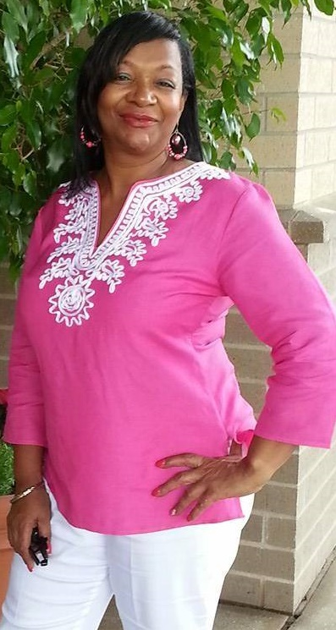
Just Talk To Me! with Audrea and Sandra Life Coaches Mentors Agents of Encouragement
Psalm 139 Woman – Gathering of the Vessels – Hilliard Edition
FIRST SATURDAYS
Hilliard Branch Library
11:30 am

Slide 2
The Encouragement Agents

Slide 3
Our Mission
We want to encourage and empower women to press to reach their fullest potential so that they can discover and pursue their purpose and walk out their destiny. Women are actively encouraging others while encouraging themselves, reaching across generational boundaries, learning from each other.

Slide 4
Be Encouraged!
Superwoman is non-existent – trying to be her will kill you!
God forgives and forgets and so should you!
Don’t you know that God has more for you?
You have not seen your best days yet!
There’s more before you than there is behind you.
You can start over. You can be healed. You can start having good things in your life to replace the bad things.
God’s plans are so much better than ours.
Allow God to cleanse your heart from the fear of change.
You can call upon God even in the middle of the night.
In order to move forward, we must be willing to give up yesterday and go on toward tomorrow.

Slide 5
Clarity of Purpose
Jeremiah 29:11 For I know the thoughts that I think toward you, says the Lord, thoughts of peace and not of evil, to give you a future and a hope.
God created you with a “purpose” and a “plan” – Ecc 3:1
You’re not a surprise to God, He had you on His mind.
What would you do and enjoy even if you were not getting paid to do it. There is where you will find your purpose.
Celebrate who you are. You are the image of God!
Everything God will do for a man. He will do for a woman.
You will never get it straight without Jesus! Come just as you are!

Slide 7
How We View Ourselves vs How God Views Us
Psalm 139
Explore details and insert yourself in the passage
Realize/Understand/Embrace the fact that you are…
Special/Unique/Purposefully designed for a reason
Change all wrong thinking

Slide 8
Whatever It Is… Let It GO!!!
Whatever it is that has been plaguing you, holding you back, keeping you from even entertaining the possibility of rising to your fullest potential, just release it. Let it go! Replace the wrong thinking, the wrong thoughts, the ideas that oppose what God says about you and replace them with words of life, words of hope, promises of the future that is yours. Get rid of the barriers and the blockages and get ready to dream again! Listen to Gail Holmes as she delivers this message in song and begin to think about what you will release so that you can soar!

Slide 10
All About Me!
Self-assessment of…
your attributes, your gifts, your talents
Don’t shy away from pointing out the positives
Great things are in you because God placed them there
Don’t forget to “flip the script” on the enemy
Discovered faith and resolve you didn’t know you had
Learned to trust God even more because of
what you’ve come through

Slide 11
You Are Unique!
Be YOU!!
Learn to love who God created you to be and to appreciate the gifts, talents, abilities, and accomplishments of your sisters. United we can do so many things. Stop comparing and start collaborating! There are people to be touched, lives to be changed, and changes to be made. Women encouraging women... It's a WONDERFUL thing! ~ Psalm 139 Woman

Slide 13
Do You Really Know Who You Are?

Slide 14
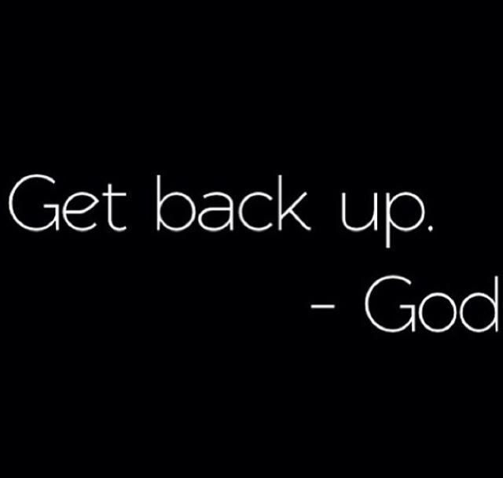

Slide 15
Never too late to change… Meet Antoinette (Toni)

Slide 16
The Challenge
Press your way to dream
Visualize and Record
Get ready to produce your Vision Board(s)
Find examples of Vision Boards
Gather materials for your project

Slide 18
Morning Time… Joy Comes in the Morning!
Life may have dealt you many blows that knocked you out… but they didn’t take you out of the game. Even as you begin to look up and move forward, the process of change, purging and healing may prove to be painful. Don’t allow yourself to be overwhelmed. Keep moving forward knowing that as you push and press your way, sometimes with tears streaming down your face, JOY is coming your way. Listen and reflect as Bishop George Davis lets us know what time it is!

Slide 19
Homework
Prepare to make two vision boards…
Vision Board – Who are you?
Words and pictures that describe who you are
Vision Board – What do you see/dream about/desire?
Not necessarily big goals for the future…
Something you want to accomplish
Something you have put off
Something you would like to overcome

Slide 20
Next time…
Vision Board Party!!!

Slide 21
Whatever It Is… Let It Go

Slide 22
Morning Time… Joy Comes in the Morning!

Slide 23
Bring pictures, words, phrases that describe YOU
so you can do a board that gives an accurate description of who you are,
now that you are lining your thoughts about yourself up with what God says about you.
AND
Bring pictures, words, phrases that depict those
dreams, visions, goals, aspirations
that you desire manifest in your life.
Take them down off the shelf, dust them off,
speak life to them, and
start dreaming again!
Get ready to "paint the picture" so that
you will always have a reminder of where you are going as a way of encouraging you to stay the course
and to never give up!

Slide 24
You will use words, phrases, pictures, or symbols that depict who you are now that you see yourself as God sees you. Get ready to create a VISION BOARD that will accurately describe you now that your thoughts line up with what God says about you!
AND
You will use pictures, words, phrases, symbols, etc. that help to illustrate those dreams, visions, goals, and desires that you may have put on the shelf. It’s time to take them off that shelf, dust them off, and start dreaming big again! You will create a VISION BOARD that will serve as a reminder of where you are going so that you can be encouraged to stay on track and not even entertain the idea of giving up!

Slide 25
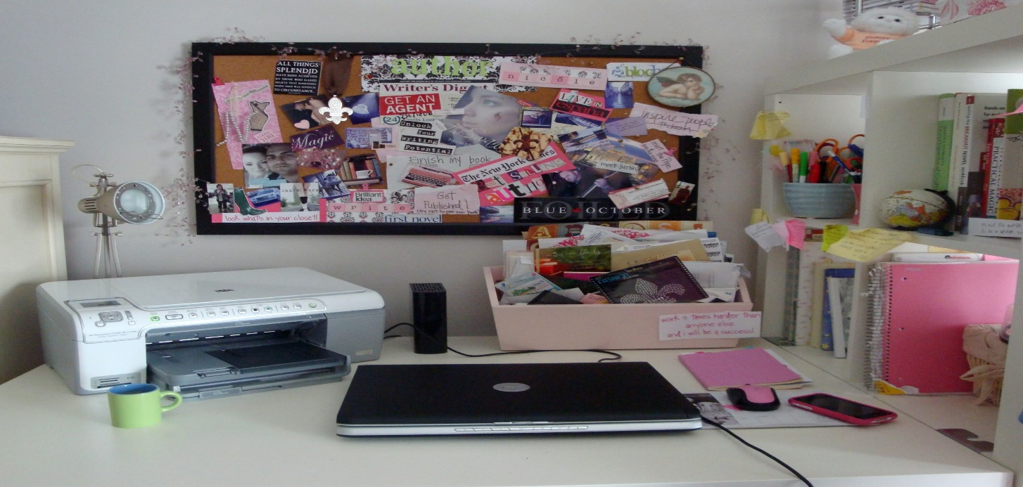
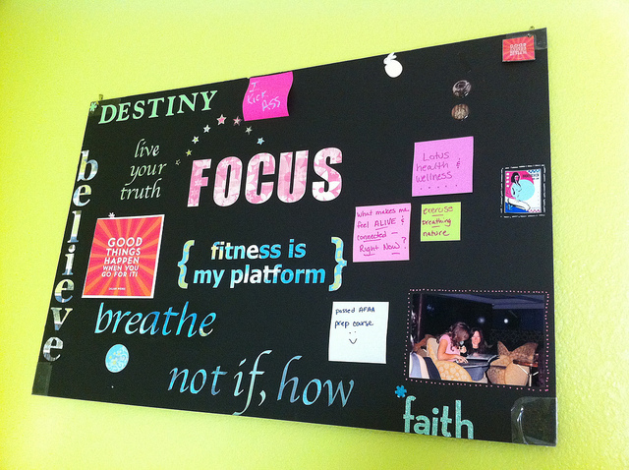
Don’t miss the
VISION BOARD PARTY!!!

